Slide 1

KiddiesTime: From Static Pages to a Working Website
A web development project: where it started, how it improved, and who it helps
Notes:
Welcome everyone. This presentation tells the story of my KiddiesTime website: where it started, how I improved it in Part 3, and why it matters to parents and to the business. The clock in the logo reflects our name: children around the clock.

Slide 2




The Business Behind the Website
KiddiesTime
A small Bloemfontein day care centre that grew from a few learners in one room to many.
Who it serves
OUR SLOGAN
Where little minds grow, play and shine every day.
Parents looking for a safe, joyful place for their children to learn and play.
The goal of the website
Vision: a centre where children dream big, learn joyfully and grow into confident, caring leaders.
An online home where parents learn about us, see our services and get in touch.
Notes:
KiddiesTime is a small day care in Bloemfontein. The website's job is to be a digital front door: parents should be able to learn who we are, see what we offer, and contact us without picking up the phone first.

Slide 3

The Proposal: Where It All Began
2–6
years: the age range of the children
The gap I spotted
KiddiesTime had no website, so parents wanting to apply for their children had no easy way to find it.
90%
enrolment goal for KiddiesTime
Who it is for
85%
retention goal: families who stay
Parents of children aged 2 to 6 years, including working parents who need dependable care.
The five key goals in my proposal:
Quality learning
Safety first
Growth
Skilled staff
Parent partnership
Notes:
Everything began with my proposal. KiddiesTime had no website, and I argued that one would make it easier for parents to apply and help the centre grow. The proposal set the target audience, parents of children aged 2 to 6, and five key goals, including reaching 90% enrolment with 85% retention. The website is meant to support those goals.

Slide 4
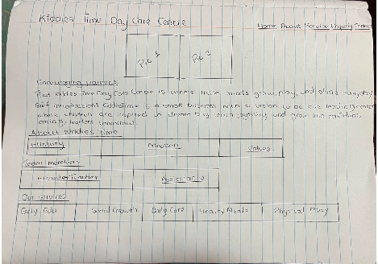


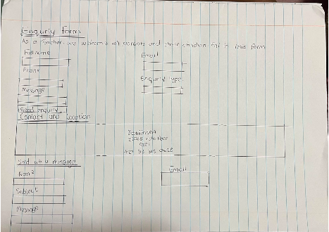



From Sketch to Site Map
Home
About
Services
Main heading, tagline, call to action and a brief introduction
History, mission, values and the team members
Early education, social growth, daily care, healthy meals, physical play
Enquiry
Contact
Every page
Name, email, phone, enquiry type, message and a send button
Location in Bloemfontein plus a form: name, email, subject, message
Logo and five-link navigation bar, plus a footer with tagline and copyright
Hand-drawn wireframes from my proposal
Notes:
Next I sketched the pages by hand and drew a site map showing what each page should contain: the home page, about, services, an enquiry form, and a contact page, all sharing the same navigation bar and footer. Every one of these sections made it into the final website.

Slide 5

Parts 1 and 2: Building the Pages
Home
About
Services
Enquiry
Contact
Welcome message, vision and a preview of our team
History, mission and our SLERF values
Five services that support each child
A form for volunteers, sponsors and general questions
Location, phone number and a message form
Built with HTML and CSS: one consistent layout, clear navigation and the same look on every page.
Notes:
In the first parts of the project I built the foundation: five linked pages with a shared navigation bar and a consistent design. It looked like a real website, and it gave parents the basic information.

Slide 6

What Was Still Missing
Forms that did nothing
A fixed services list
Visitors could type into the forms, but nothing was checked, sent or answered.
Five cards typed by hand, with no way to search, filter or sort them.
Hard to find
Not yet online
Basic page titles, with no descriptions or search engine setup.
The website only lived on my own computer.
Notes:
The site looked good, but it was a brochure. Nothing on it actually worked: the forms did nothing, the services were fixed, search engines had little to go on, and no one outside my computer could see it. Part 3 was about closing every one of those gaps.

Slide 7



The Plan: Four Upgrades
01
02
03
04
JavaScript
SEO
Forms
Deployment
Interactive and dynamic content, with search, filtering and animations.
Titles, headings, alt text and files that help search engines find us.
Validation, clear errors and a useful response after submitting.
Publishing the site on a free platform so anyone can visit.
First, I applied the feedback I received on Part 2. Then I worked through these four upgrades.
Notes:
Part 3 asked for four things: add JavaScript, optimise for search engines, build working forms with validation, and deploy the site. Before that, I worked through the feedback on Part 2 so the foundation was solid.

Slide 8





Bringing the Services Page to Life
Live search
results update as you type
meals
Category filter
Learning, Care or Wellbeing
All categories
Default order
Sorting
A to Z, Z to A or by category
Showing 1 of 5 services
Healthy Meals
Built with JavaScript
cards are drawn from a data list
Serving nutritious snacks and lunches during the day.
Animations
sections fade in and cards lift on hover
Care
Notes:
Here is the services page after the upgrade. Parents can type a word like 'meals' and the list narrows instantly. They can also filter by category and sort the results. The cards are created by JavaScript from a list of services, so adding a new service means adding one line of data. I also added gentle animations as sections scroll into view.

Slide 9
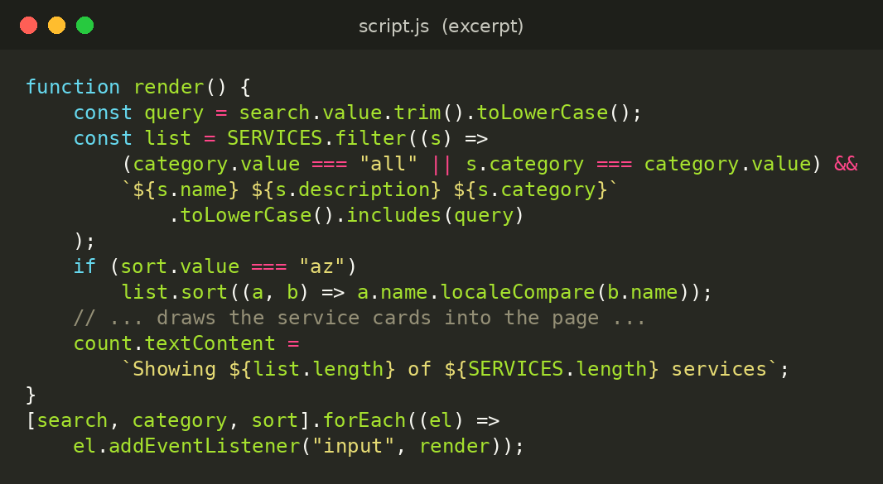

The Code: Live Search and Filter
What it achieves
Results update on every keystroke, with no page reload
Filtering and sorting work together on the same list
Adding a new service takes one line of data
Excerpt from script.js, the file shared by every page
Notes:
This is the heart of the services page. The function reads what the visitor typed, the chosen category and the sort order, keeps only the matching services, and redraws the cards. It runs every time the visitor types or changes a dropdown.

Slide 10

Forms That Check Before They Send
1
Fill in
The visitor completes the form
2
Validate
Errors appear under each field
3
Respond
An instant reply or a ready-made email
Enquiry form
Contact form
Extra fields appear for enrolments and sponsors. The reply shows fees, availability and a reference number, sent in the background (AJAX).
A validated message is compiled into an email that the visitor can send to the recipient with one click.
Every field is checked before anything is sent:
Name
Email format
SA phone number
Future start date
10–500 character message
Notes:
Both forms now validate everything before it is sent. If something is wrong, a clear message appears right under that field. The enquiry form shows different fields for enrolment or sponsorship and then gives an instant reply with fees and availability. The contact form turns the message into an email the visitor can send to us. The prices on this reply are sample values that I would replace with the real fees.

Slide 11
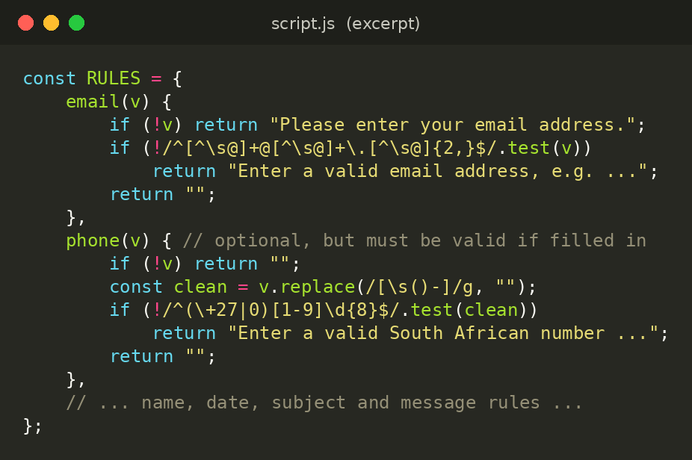
The Code: Checking Every Field
What it achieves
Mistakes are caught before anything is sent
A clear message appears under the field that needs fixing
Phone numbers are checked against South African formats
Excerpt from script.js: one rule per type of field
Notes:
Each rule looks at what the visitor typed and returns either an error message or nothing. The email rule uses a pattern for a valid address, and the phone rule accepts South African numbers starting with 0 or +27. The forms use these same rules, so they behave consistently.

Slide 12
Making KiddiesTime Easy to Find
5/5
pages, each with its own title and description
Titles and descriptions
use the words parents search for
Clear headings
one H1, then H2 and H3 in order
2
files guide search engines: robots.txt and sitemap.xml
Image alt text
descriptive text for the logo and images
Internal links
pages point to each other
1
block of local business data for Bloemfontein
Mobile-friendly
layout that works on phones
Quick and safe
deferred scripts and security headers
Notes:
Search engine optimisation is how a parent searching for a day care in Bloemfontein can find us. Every page has its own title and description, headings are in a logical order, images have alt text, and I added a sitemap and robots file. I also added local business details so search engines know where we are.

Slide 13
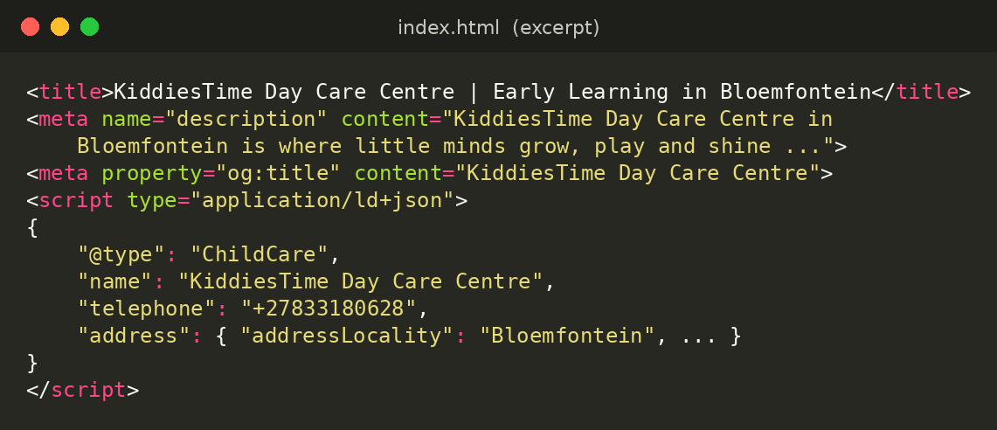
The Code: Search Engine Tags
What it achieves
Each page has its own title and description for search results
Local business data points search engines to Bloemfontein
Excerpt from index.html; every page follows the same pattern
Shared links show a proper title and description
Notes:
These tags sit in the head of every page. The title and description are what appear in search results, the Open Graph tags control how a shared link looks, and the structured data tells search engines that KiddiesTime is a child care business in Bloemfontein.

Slide 14
Before and After
Area | Before | After
Services | A fixed list of five cards | Searchable, filterable and sortable, drawn by JavaScript
Forms | Plain fields with no checks | Validation with clear error messages under each field
Enquiries | Nothing happened on submit | An instant reply with fees, availability and a reference number
Contact | Nothing happened on submit | A ready-to-send email for the recipient
Findability | Basic page titles only | Titles, descriptions, headings, sitemap and robots.txt
Online | Only on my own computer | Hosted free on Netlify, open to anyone
Notes:
This table sums up the journey. Every row is something that was either missing or not working at the start and is now working. The point is not that the site looks different, but that it now does real things for visitors. Hosting on Netlify is the plan for deployment, so I would update this row if I use a different platform.

Slide 15

Going Live: Hosting and Security
1
Build and test
Built-in protection
Run every page locally and check each form and link.
2
Publish for free
Security headers sent with every page
Drag the project folder onto Netlify. There is no server to manage.
A hidden spam trap on the enquiry form
3
Share the link
Parents open the same site on any phone or computer.
Visitor input is checked, then escaped before it is shown
Notes:
Deployment means putting the site on a free hosting platform. With Netlify I drag the project folder onto the page and get a public link. I also added basic protection: security headers, a hidden field that catches spam bots, and checks on everything visitors type.

Slide 16



Who Benefits
Parents
KiddiesTime
Me, the developer
Find services in seconds
See fees and availability up front
Get in touch from any phone
Enquiries arrive complete and organised
Easier for local parents to find us
A professional first impression
Real JavaScript, forms and SEO skills
Turned feedback into improvements
Published a site anyone can visit
Notes:
The website helps three groups. Parents get quick answers and an easy way to contact us. KiddiesTime gets better-organised enquiries and a professional presence that local families can find. And for me, the project built real skills in JavaScript, forms, SEO and deployment.

Slide 17

Thank You
A static brochure became a working website that parents can search, enquire through and find online. Any questions?
Notes:
To finish: a set of linked pages became a functioning website with search, working forms, better visibility and a public home on the web. Thank you for listening. I'm happy to take any questions.

